Slide 1


Bankezy.com
Submitted To:
Mrs. Sonali Mogal
Submitted By:
Arpit Jain(233015)
Saurabh P. Patil(233059)

Slide 2
Introduction
Bankezy, a cutting-edge web-based banking application designed to enhance the user banking experience.
Bankezy revolutionizes online banking by offering user-friendly features, enhanced security, and future-focused innovations. It aims to empower users to manage their finances efficiently and securely while envisioning a continuous evolution of banking technology.
Bankezy project aims to bridge the gap between traditional banking and modern technology, providing users with a seamless and secure way to manage their financial activities. With its user-friendly interface, robust security measures, and potential for future enhancements, Bankezy is poised to redefine online banking and empower users on their financial journeys.

Slide 3
Technology Used:
Java EE: A powerful platform for building enterprise applications, Java EE provides tools and libraries to create robust, scalable, and secure software systems.
Spring Framework: This Java framework simplifies development by offering modules for various aspects like MVC architecture, data access, security, and more.
Maven: A build tool that automates project management tasks, including dependency management and consistent project builds.
MySQL Database: An open-source relational database system used to store and manage structured data efficiently.
HTML/CSS/JavaScript: These core web technologies combine to create interactive and visually appealing user interfaces for web applications.
JSP (JavaServer Pages): A server-side technology that integrates Java code within HTML to produce dynamic web content.

Slide 4
Spring Data JPA: A Spring module that simplifies database interactions by providing a JPA-based repository infrastructure.
Spring Security: A powerful framework that ensures application security by providing authentication, authorization, and protection against common vulnerabilities.
Spring Boot: An extension of the Spring framework that simplifies application setup, development, and deployment by providing defaults for various configurations.
Hibernate: An object-relational mapping (ORM) framework that bridges the gap between Java objects and relational database tables.
Spring Boot Starter Mail: A Spring module that enables sending emails and notifications from applications easily.
JSTL (JavaServer Pages Standard Tag Library): A library of custom tags for JSP, simplifying tasks like iteration, conditional logic, and data formatting.
JavaScript Libraries (e.g., jQuery): Pre-built JavaScript libraries, like jQuery, streamline development by providing ready-to-use functions for web interactions.
CSS Frameworks (e.g., Bootstrap): Pre-designed CSS frameworks, such as Bootstrap, assist in creating responsive and visually appealing web designs with minimal effort.

Slide 5
Functions:
User Registration and Login: Users can register securely using their email and password, and a verification email is sent to ensure authenticity. Once registered, users can log in with their credentials.
Fund Transfer: Users can transfer funds between their own accounts or to other users within the bank. They input the beneficiary account number and the amount, and the system ensures secure and accurate transfers.
Payments: Users can make payments to registered beneficiaries, entering details like beneficiary name and account number. The system validates the input and records the transaction for future reference.
Transaction History: Users can access a comprehensive record of their transaction history, including transaction type, amount, source, status, and timestamp, helping them track their financial activities.
Email Notifications: Automated email notifications are sent to users for important account activities such as registration, login, and transactions, enhancing communication and security.

Slide 6
Security Measures: User passwords are securely hashed and stored to prevent unauthorized access to sensitive information. Data is protected using encryption protocols to ensure confidentiality.
Responsive Design: The platform is designed to adapt seamlessly to different devices and screen sizes, offering a user-friendly experience on both desktop and mobile devices.
Validation and Error Handling: The system employs comprehensive validation checks for user inputs, ensuring accurate and appropriate data. In case of errors, clear error messages guide users toward correct inputs.
Email Verification: New users receive a verification email upon registration. By clicking the verification link, they confirm their email addresses, enhancing the security of their accounts.
Dashboard for Overview: Users are presented with a dashboard upon login, summarizing their account balances and recent activities, providing a quick overview of their financial status.
Logout: Users can securely log out of their accounts to prevent unauthorized access, ensuring the safety of their financial information.

Slide 7
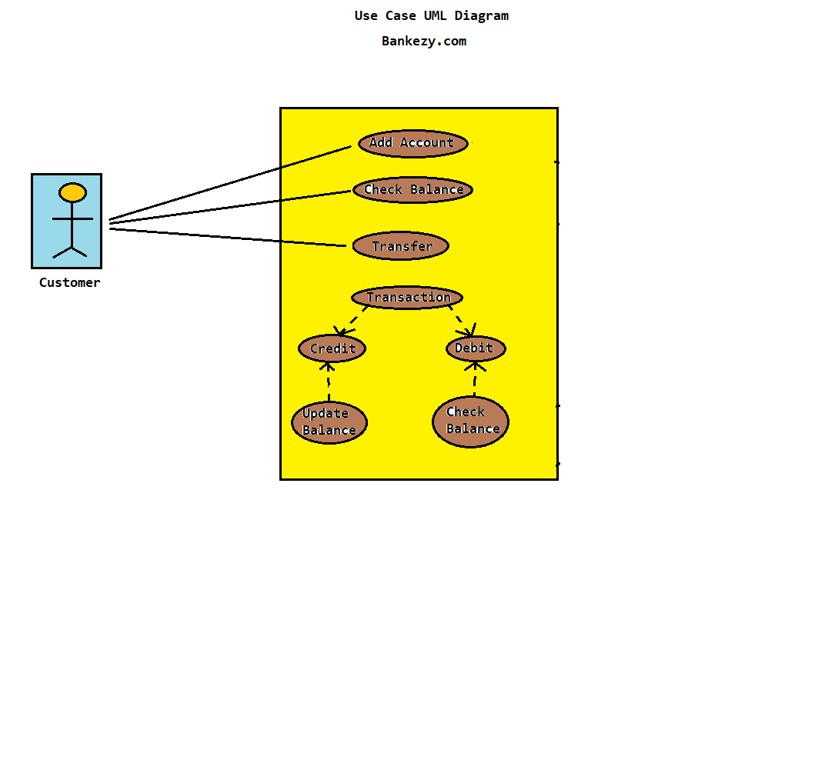
Use Case Diagram:

Slide 8
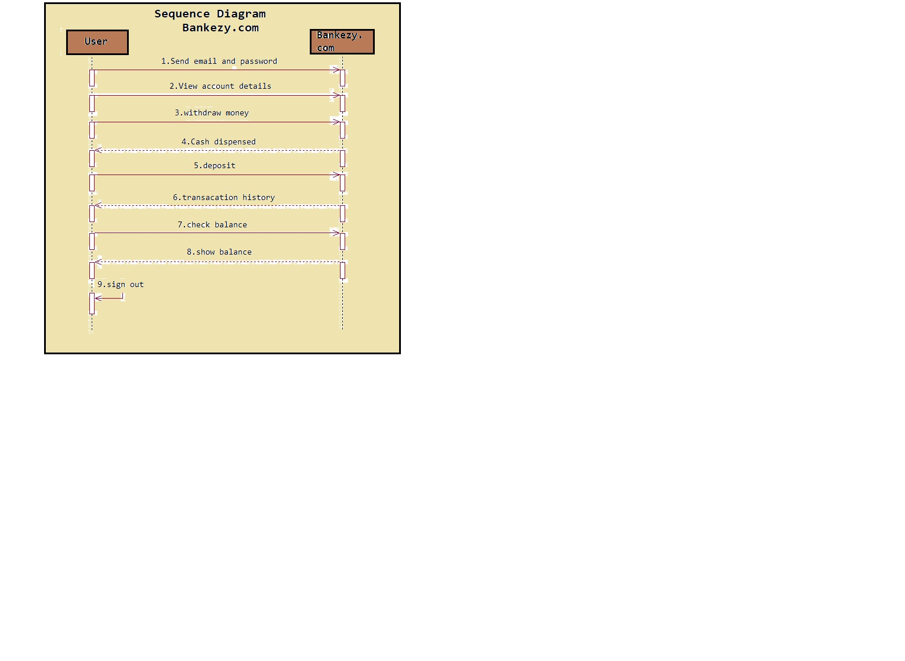
Sequence diagram:

Slide 9
Features
User-Centric Design: Bankezy, boasts an intuitive and user-centric design that simplifies navigation and enhances the overall user experience. The application adapts seamlessly to various devices and screen sizes, ensuring accessibility on both desktop and mobile platforms.
Comprehensive Account Management: Users can easily create and manage their accounts, view balances, and update account details. Bankezy offers various types of accounts tailored to users' financial needs.
Effortless Transactions: Conducting transactions has never been easier. Users can make payments, transfer funds between accounts, and keep track of their financial activities in real-time.
Transaction History: Bankezy provides users with a transparent transaction history, allowing them to review and monitor their financial transactions over time. This feature enhances financial awareness and accountability.

Slide 10
Security and Privacy: Security is a top priority for Bankezy. The project implements secure authentication and authorization mechanisms, ensures encrypted passwords, and protects sensitive user data. User privacy is a paramount consideration.
Multi-Account Management: Users can manage multiple accounts under a single profile. Flexibility to open different types of accounts for various financial needs.
Secure Two-Factor Authentication (2FA) via email verification: Adds an extra layer of security by requiring a verification through email. Mitigates unauthorized access risks.
Future-Ready: Beyond its current offerings, Bankezy envisions a future scope that includes features such as loan management, chat support, and data analytics. These enhancements will further elevate the platform's functionality and user experience.

Slide 11
ScreenShots of Bankezy:

Slide 12
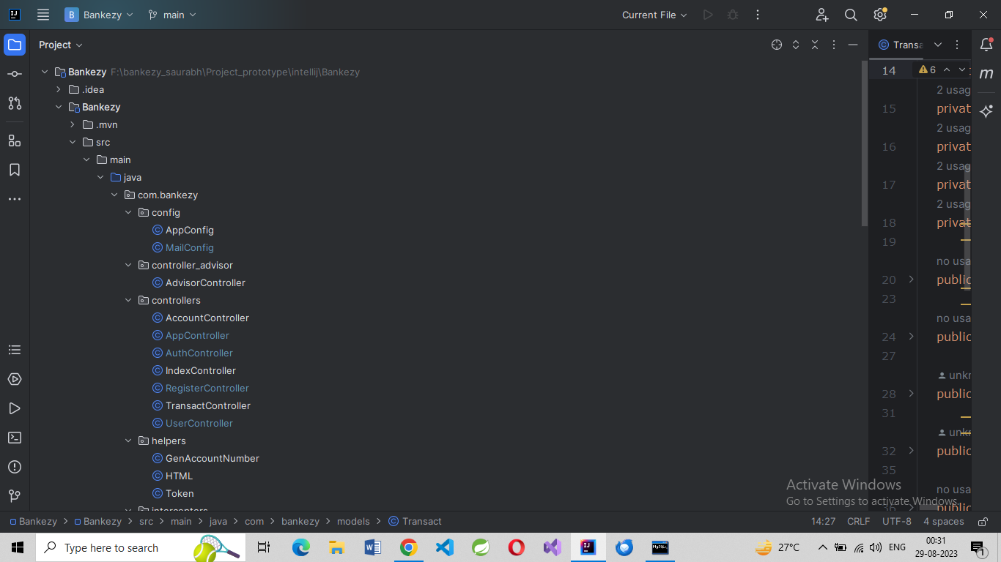
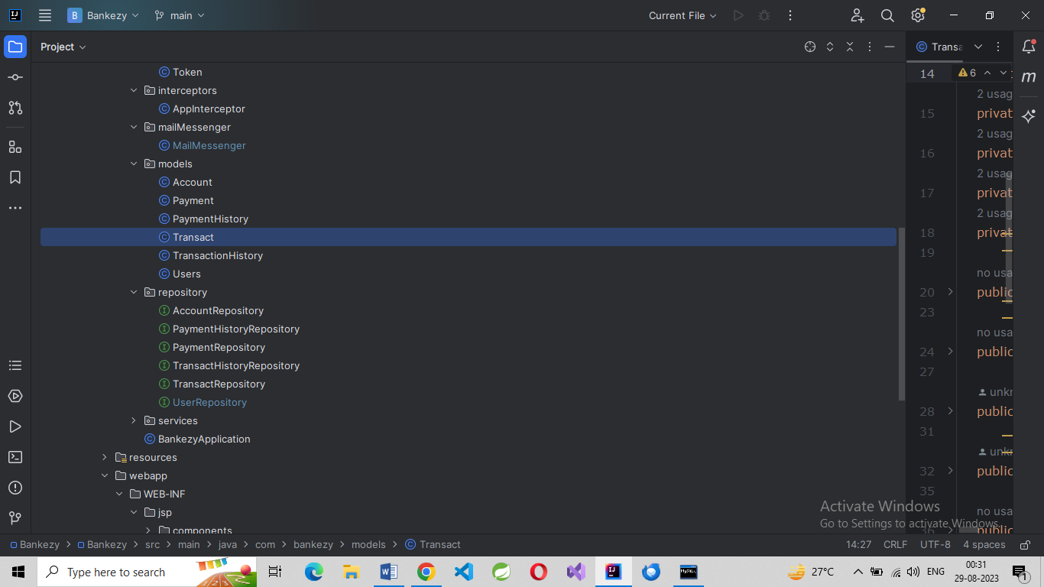
A). Folder Structure:
1
2

Slide 13
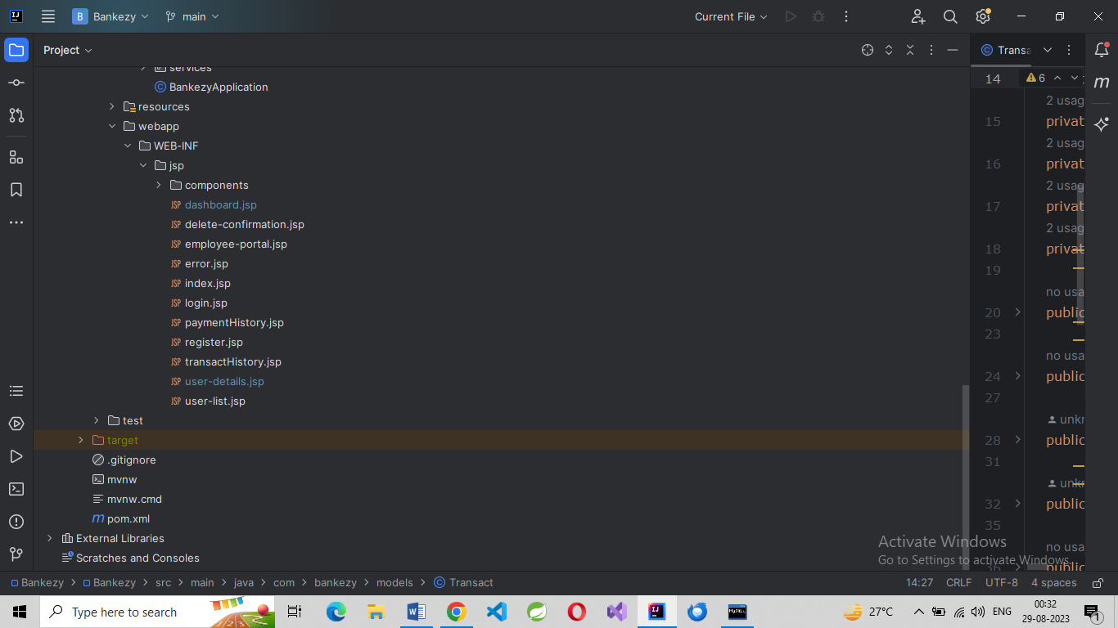
3

Slide 14
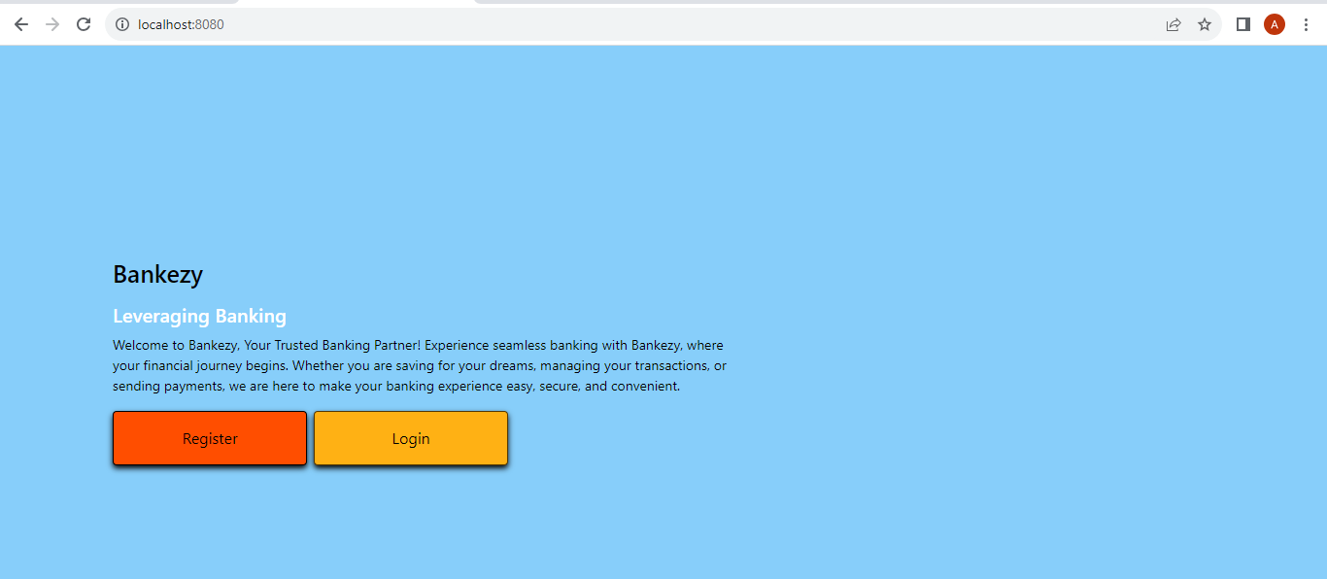
B). On AIR:
HomePage

Slide 15
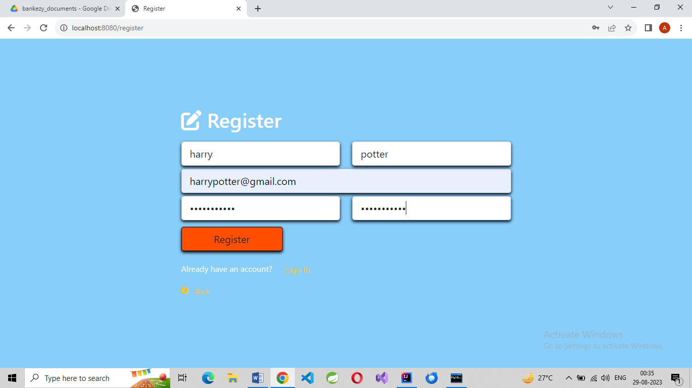
Registration Page

Slide 16
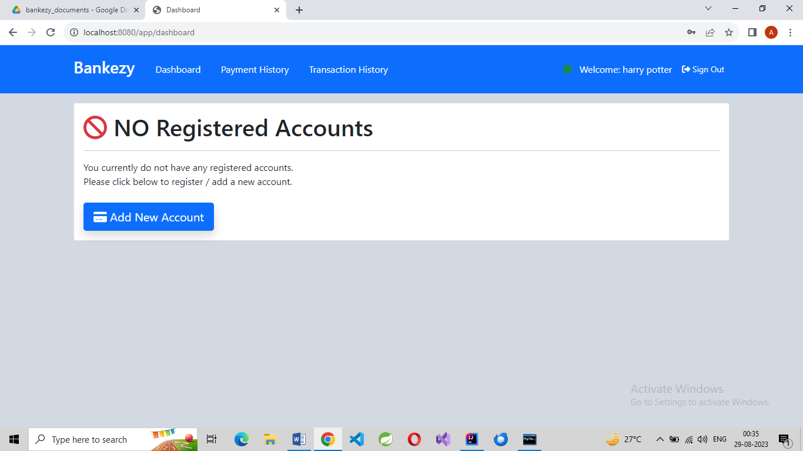
DashBoard Page

Slide 17
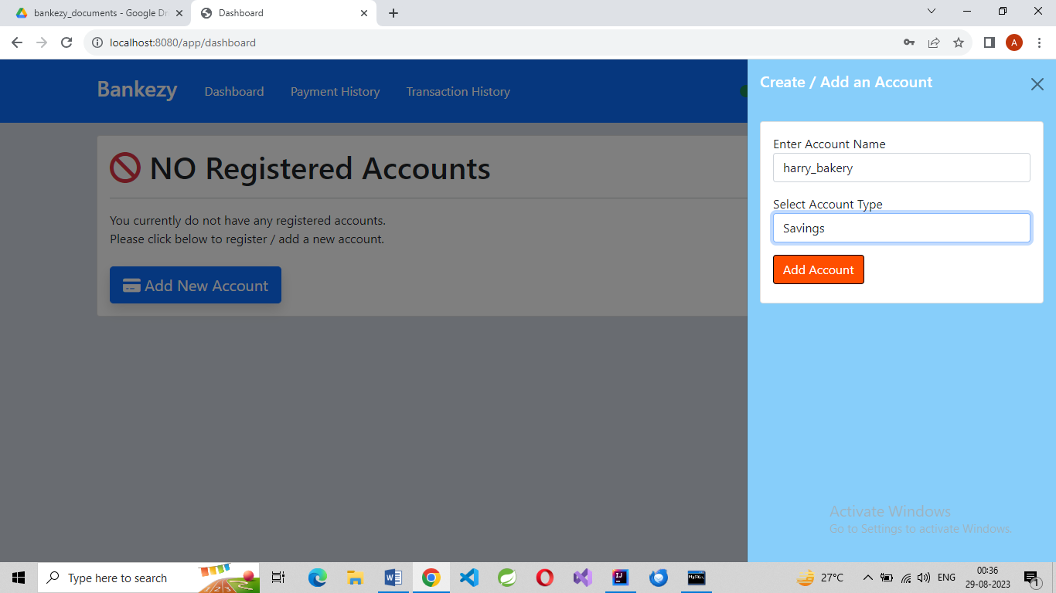
Account Opening Page

Slide 18
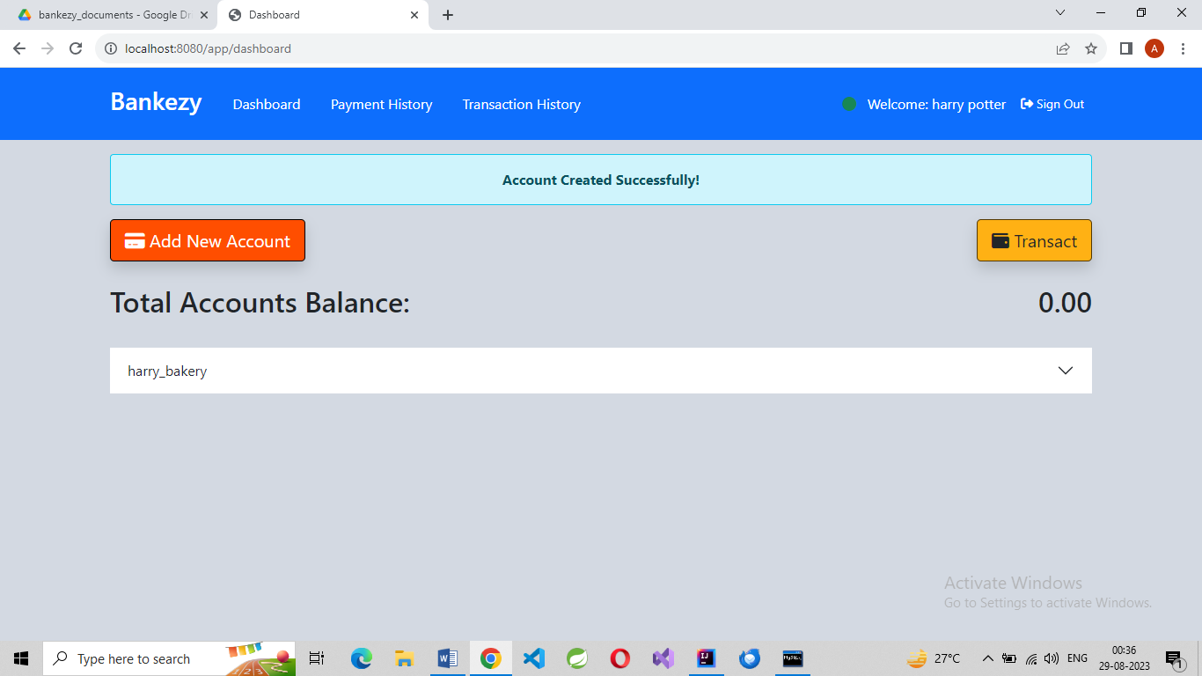
Account Opened Successfully.

Slide 19
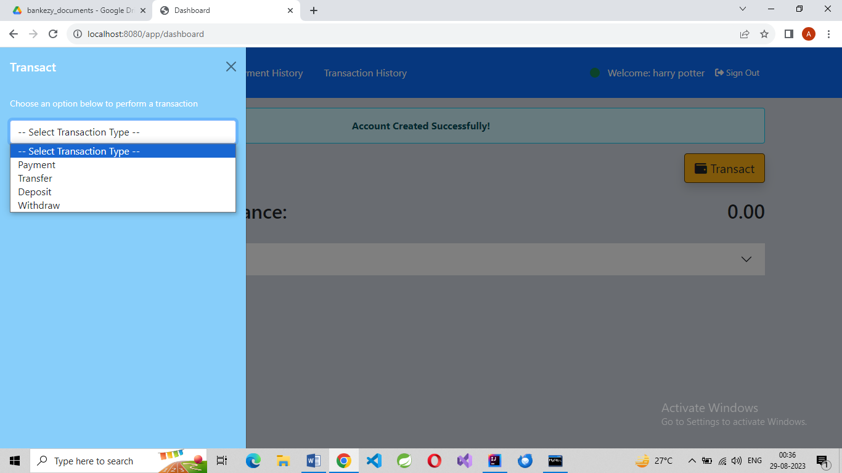
Types of Transactions

Slide 20
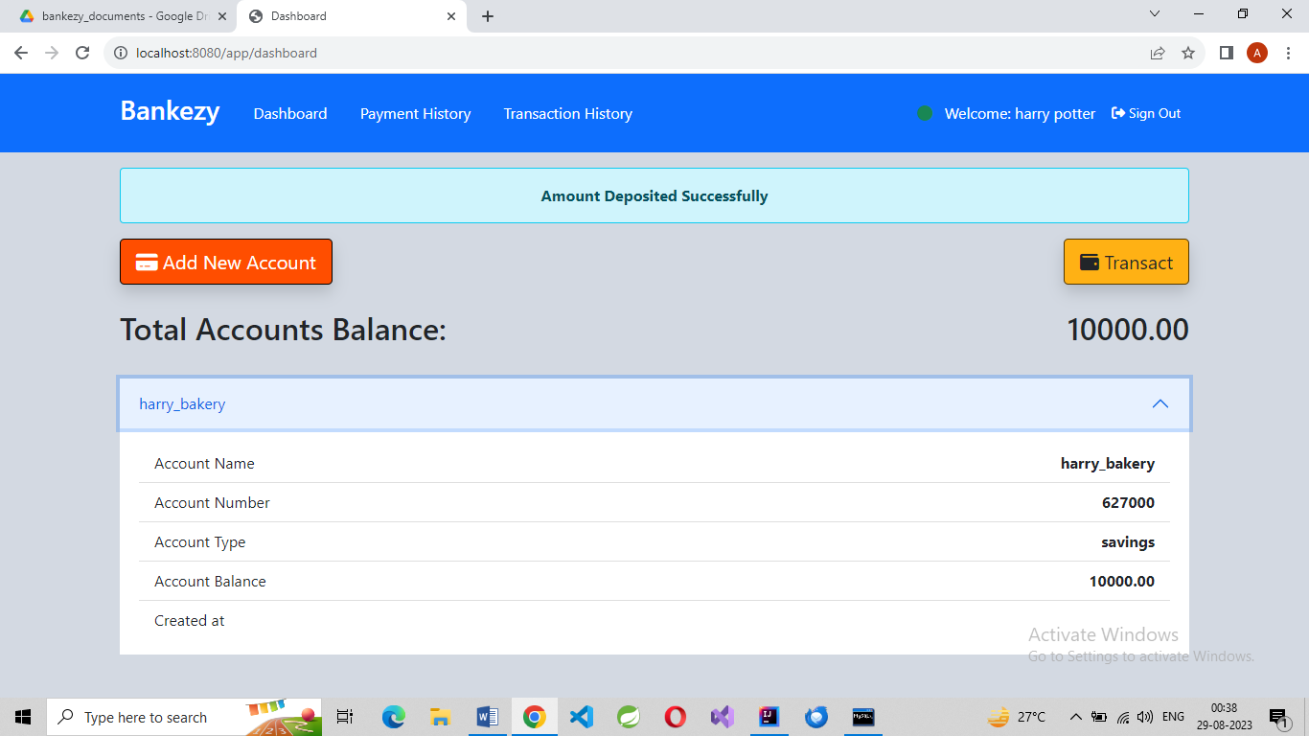
10,000 deposited

Slide 21
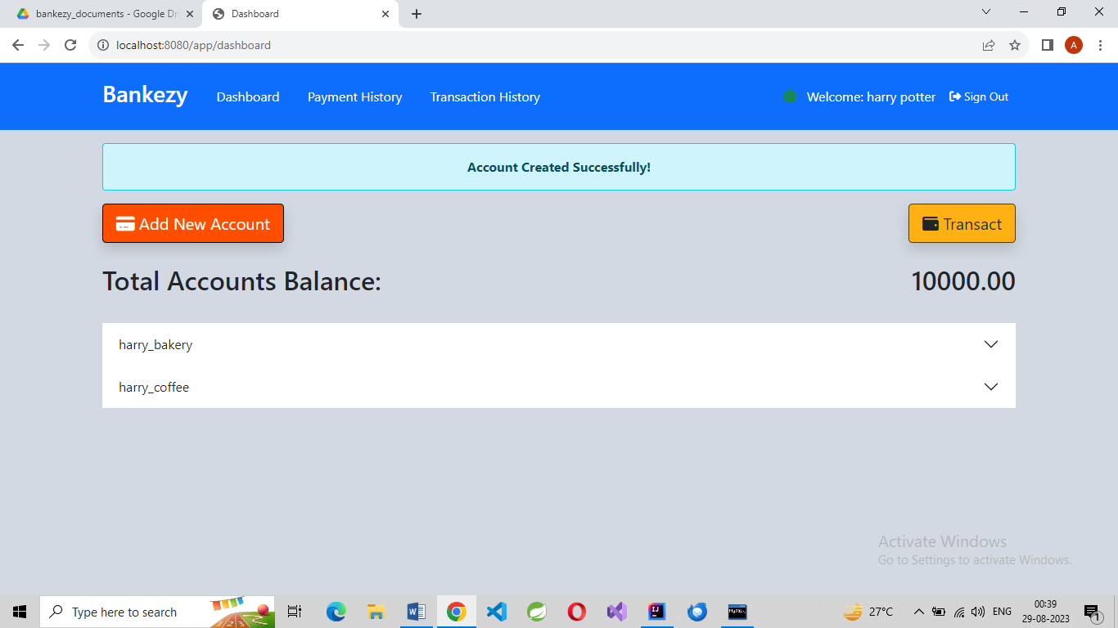
New Account Opened

Slide 22

15000 deposited in new account

Slide 23
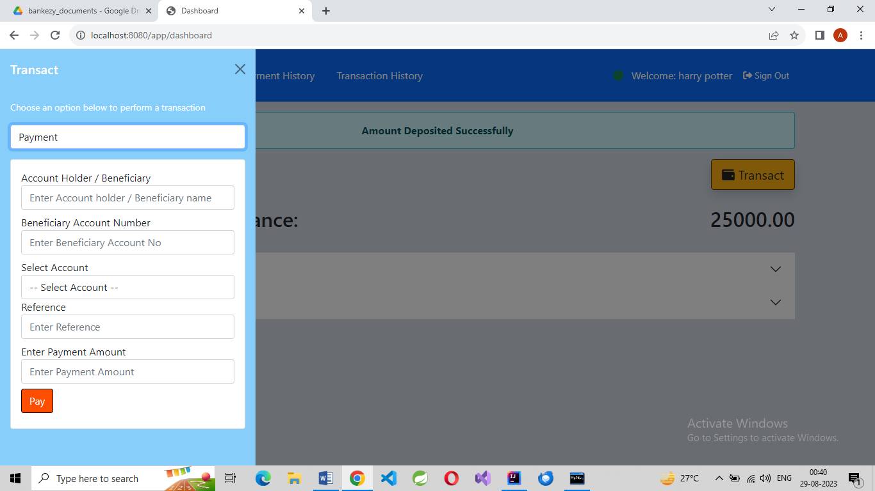
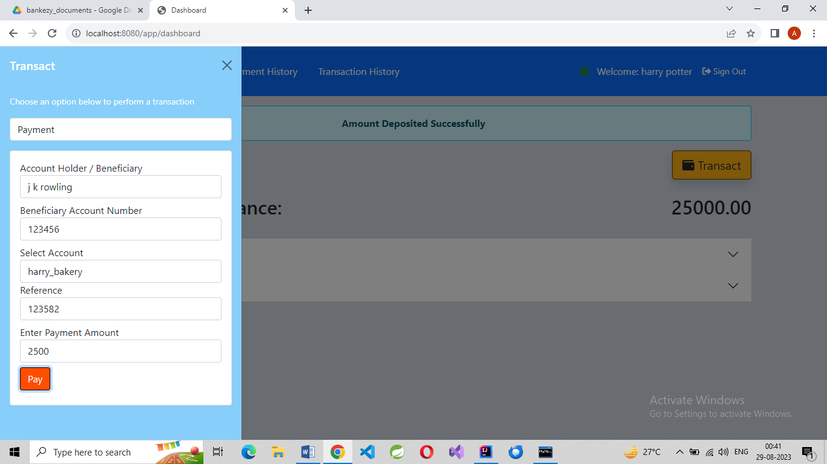
Payment to J.K. Rowling

Slide 24
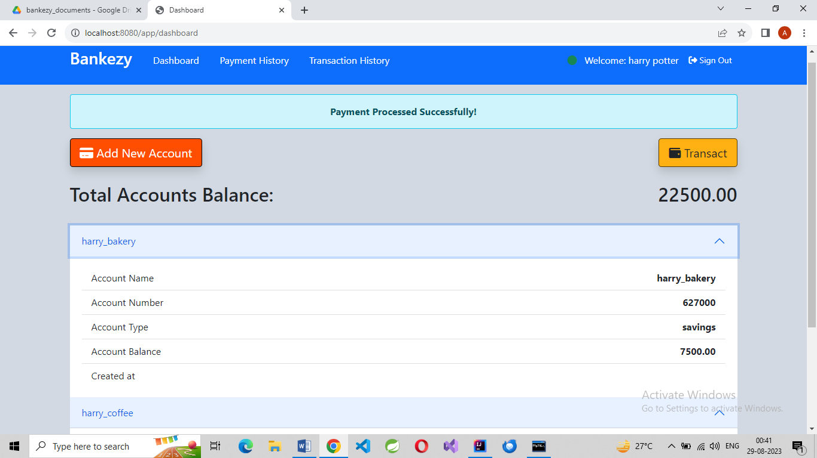
After Payment to J.K. Rowling

Slide 25
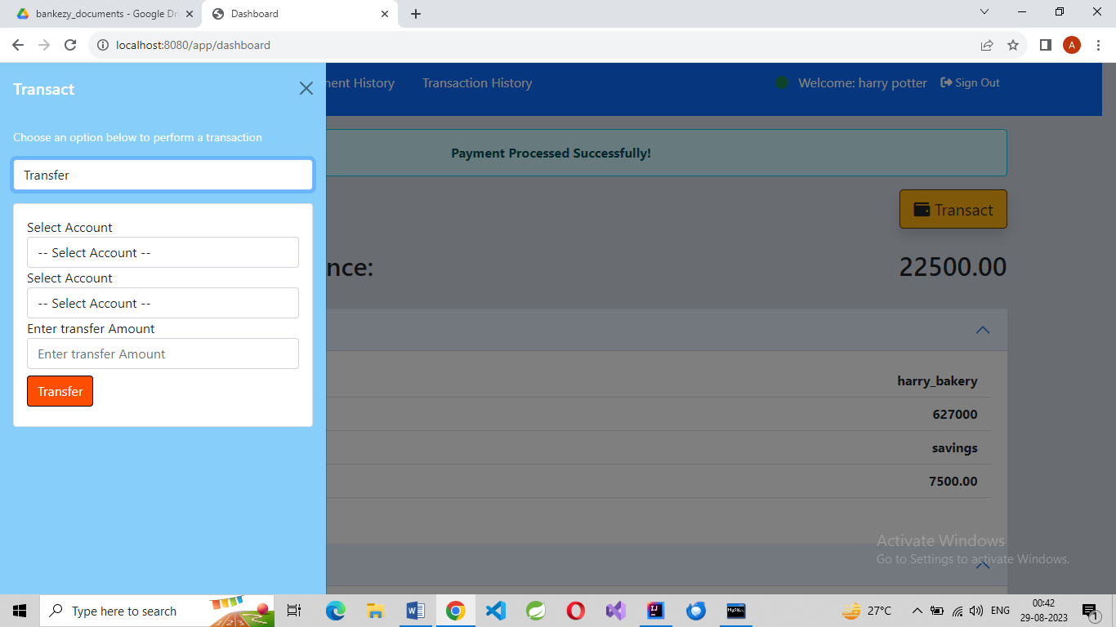
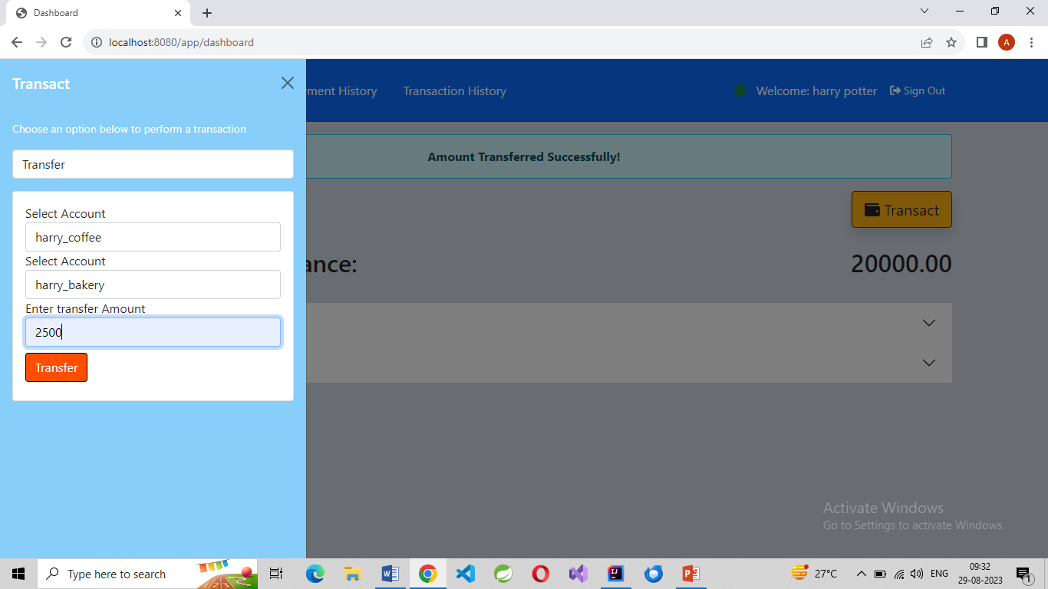
Transfer 2500 from one to other account

Slide 26
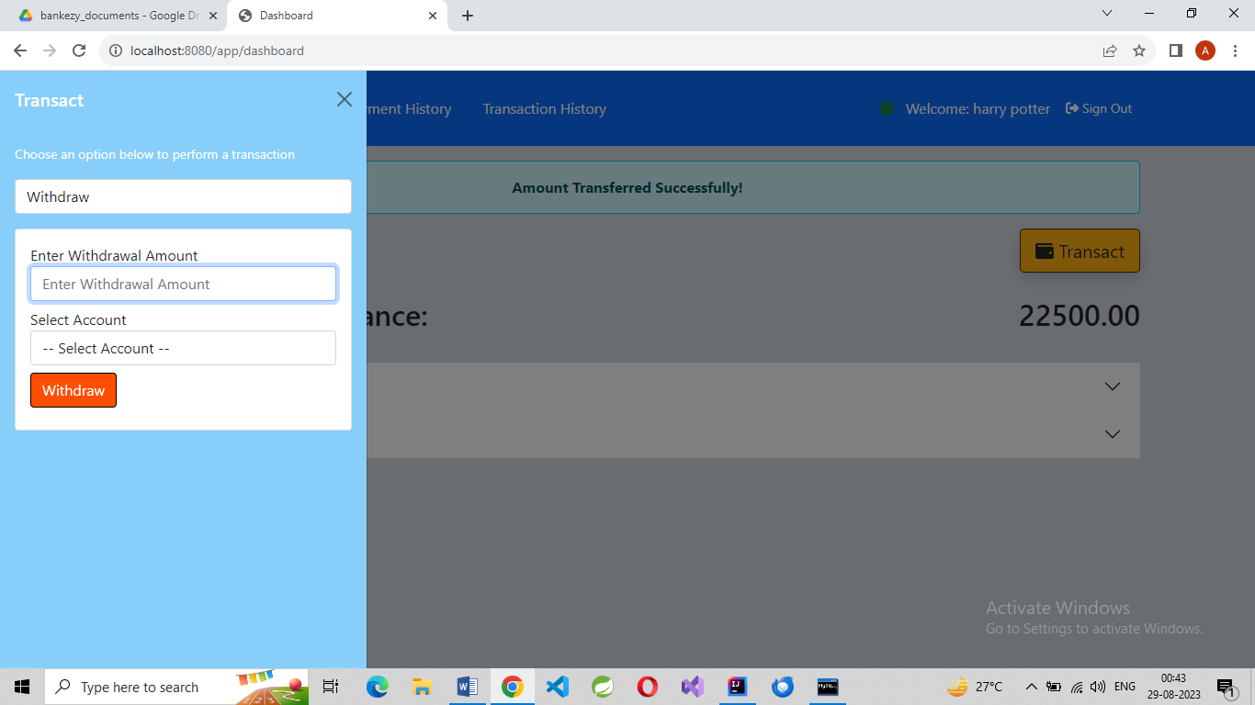

Withdrawal

Slide 27
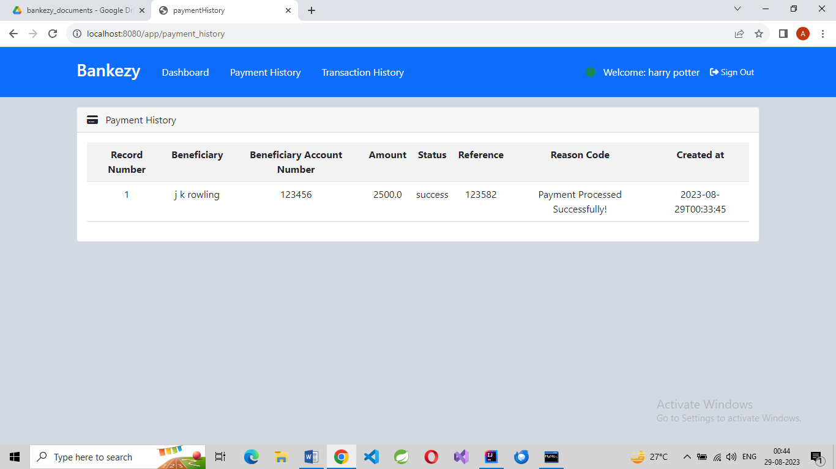
Payment History

Slide 28
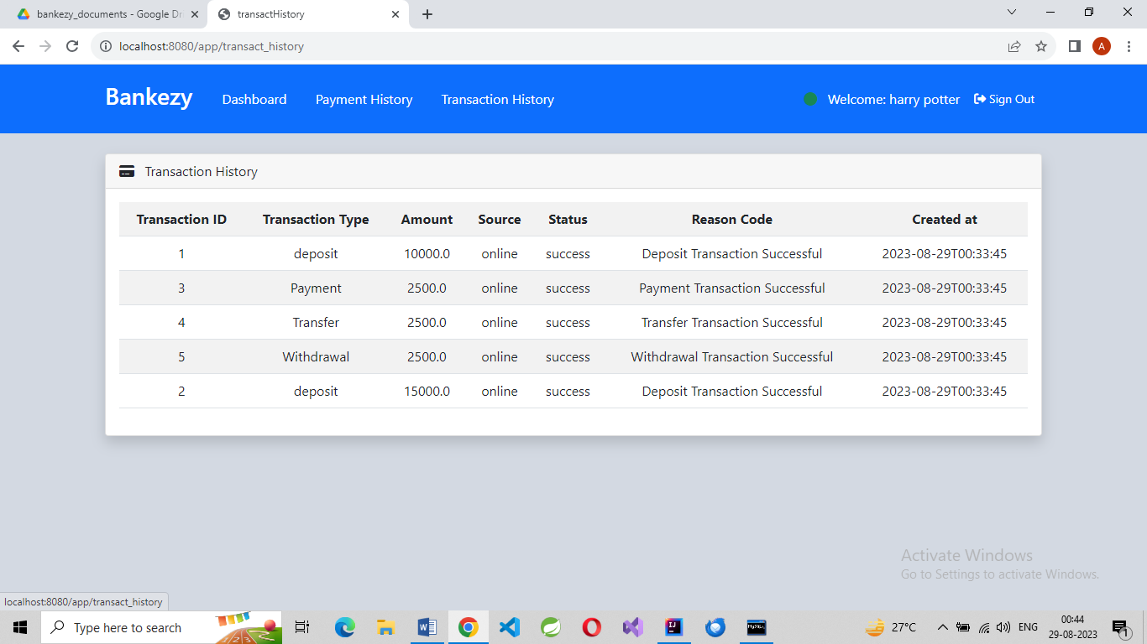
Transaction History

Slide 29
ScreenShots of Source Code:

Slide 30
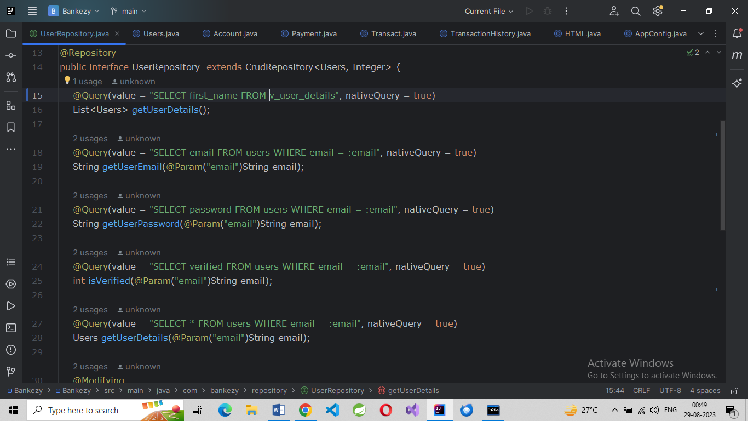
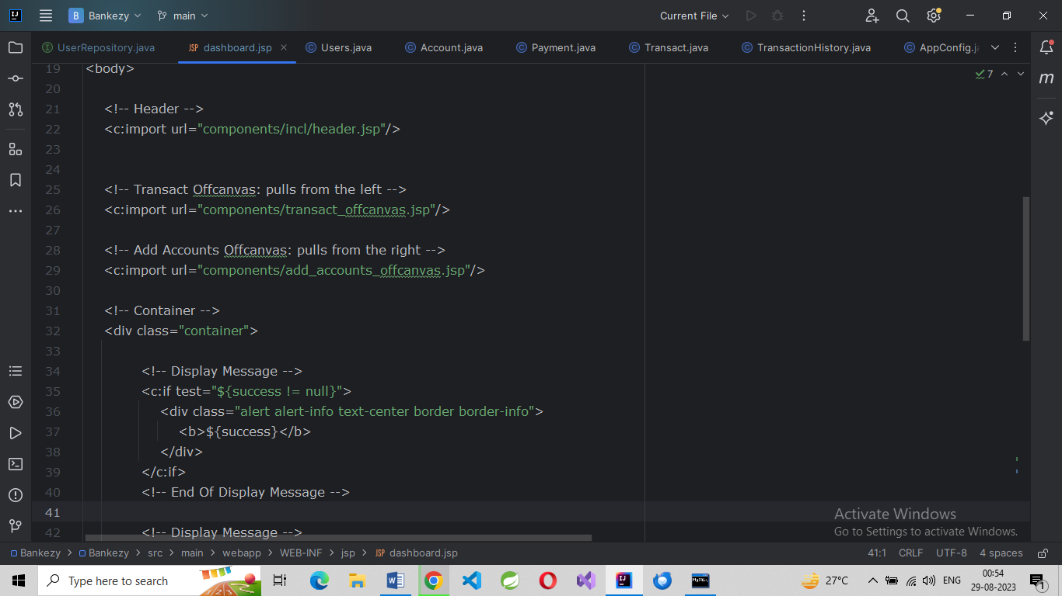
UserRepository.java
Dashboard.jsp

Slide 31
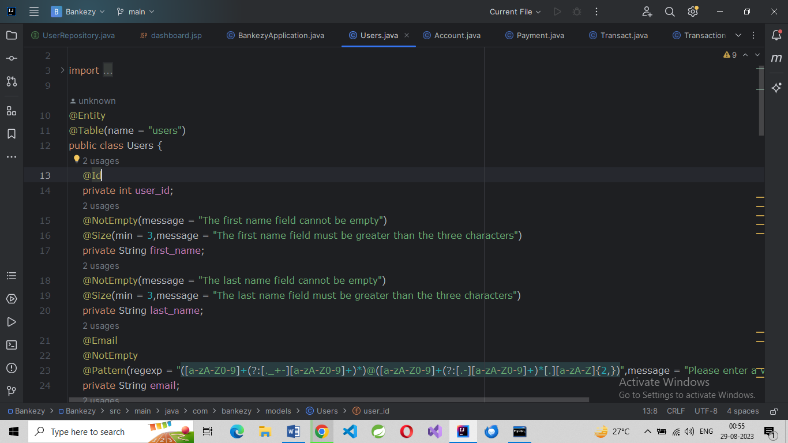
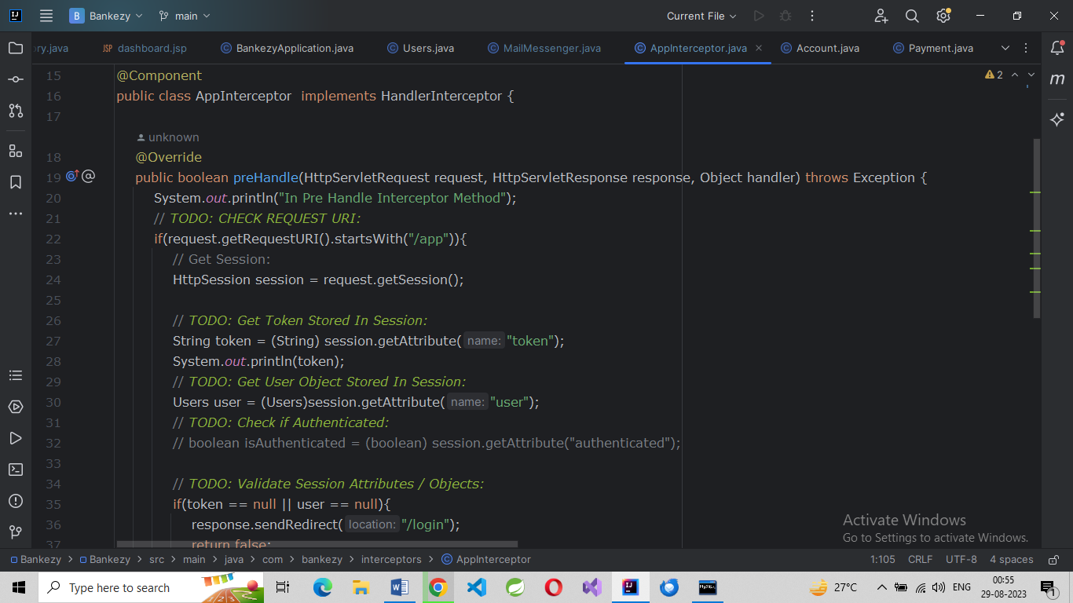
Users pojo
Interceptor.java

Slide 32
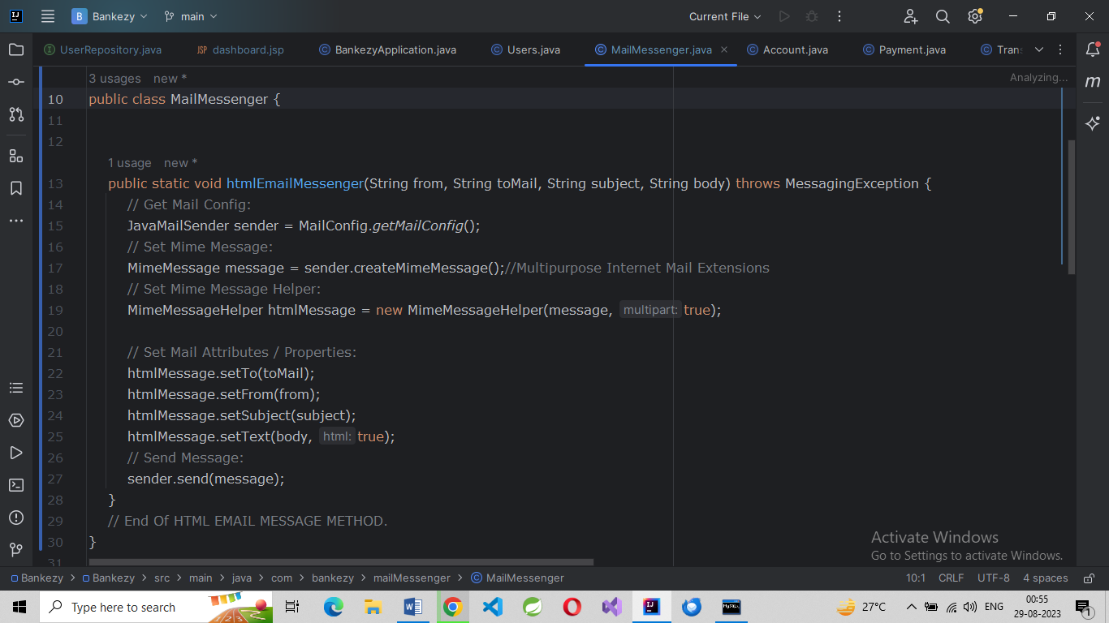
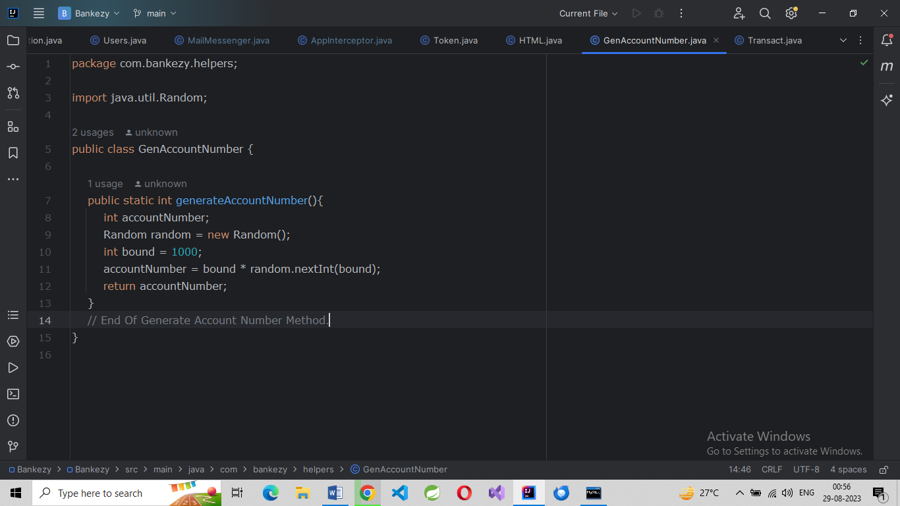
Mail API
Acc. No. Generator

Slide 33
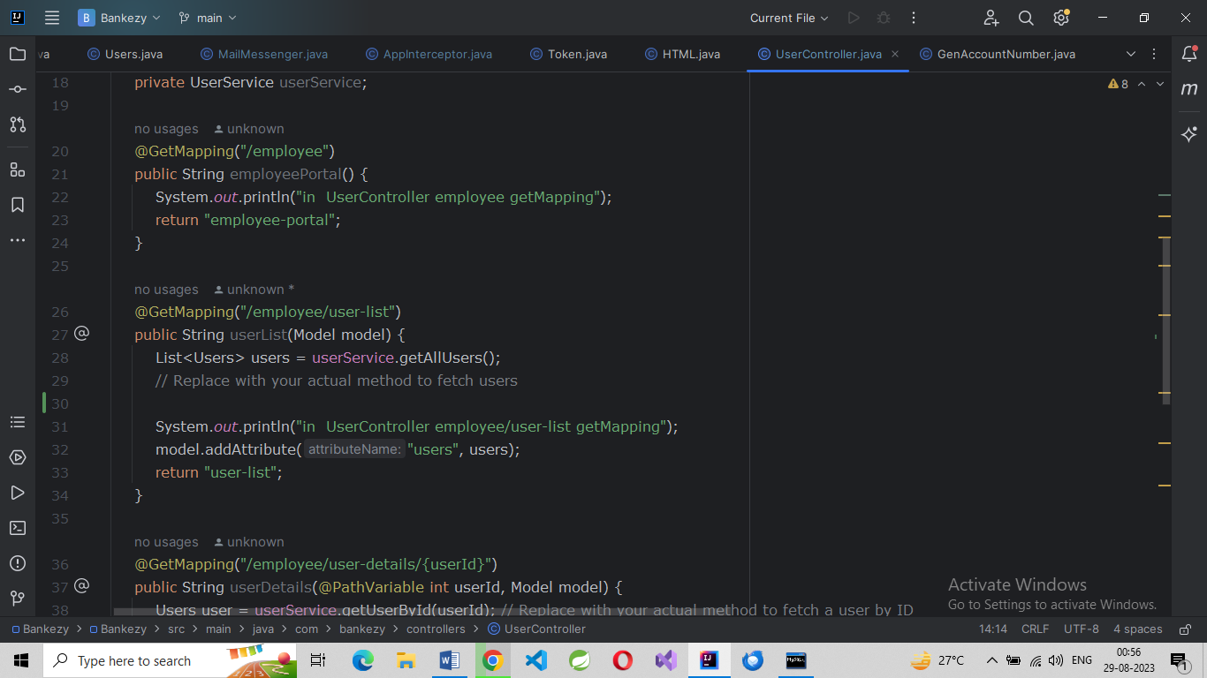
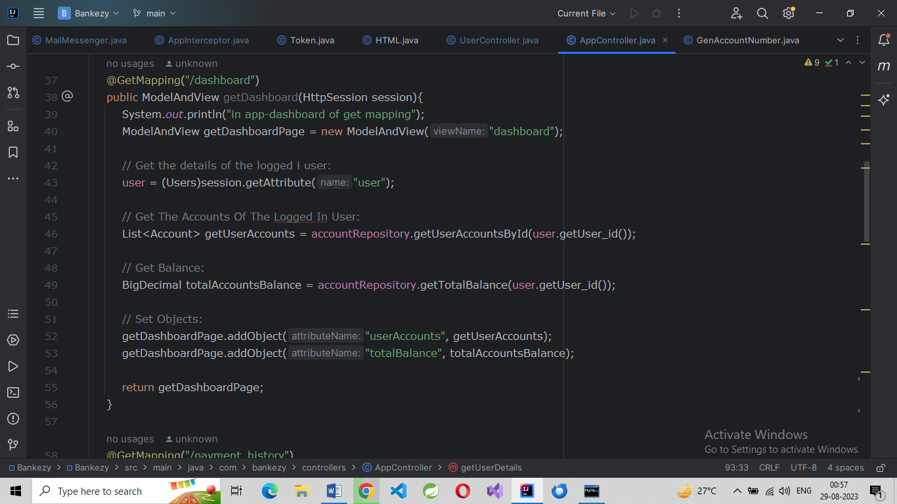
User Controller
App Controller

Slide 34
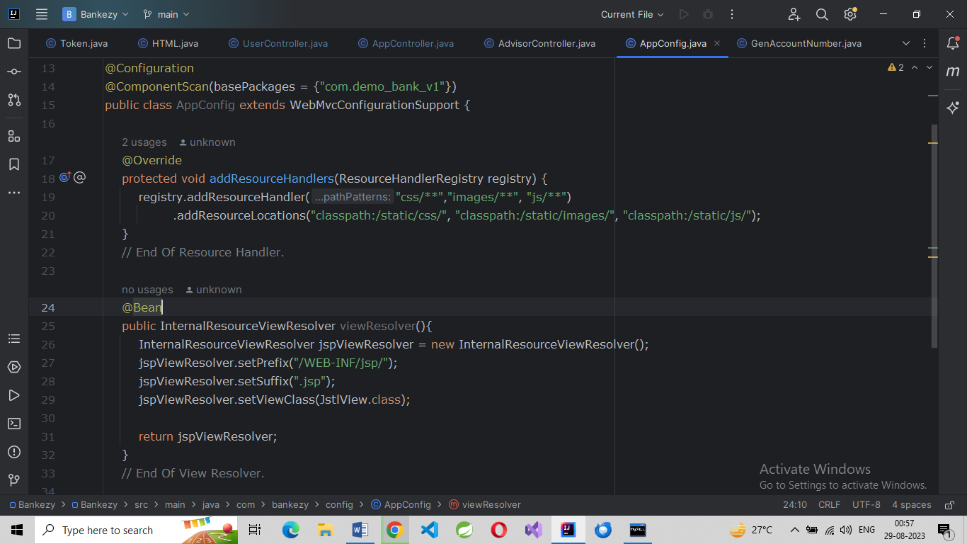
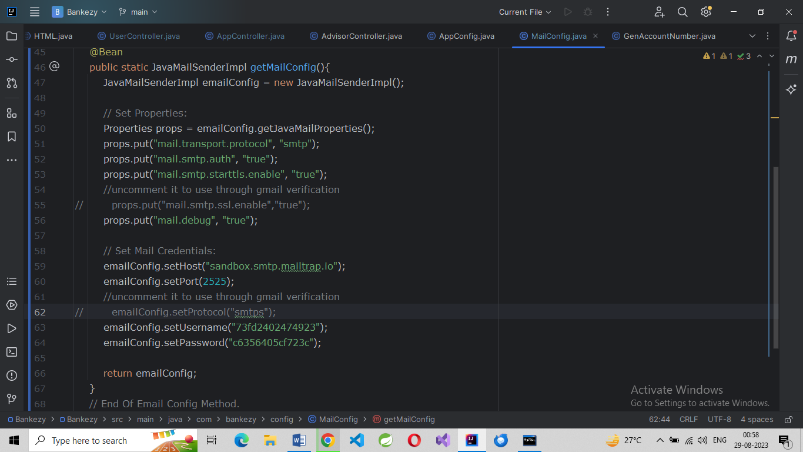
App Config
Mail Config

Slide 35
ScreenShots of MySQL Database:

Slide 36
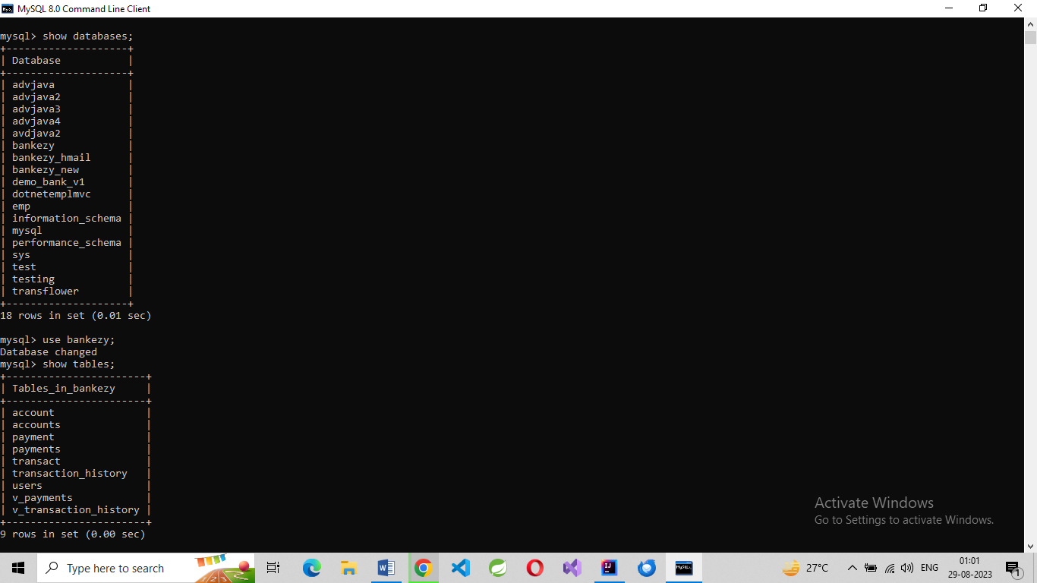
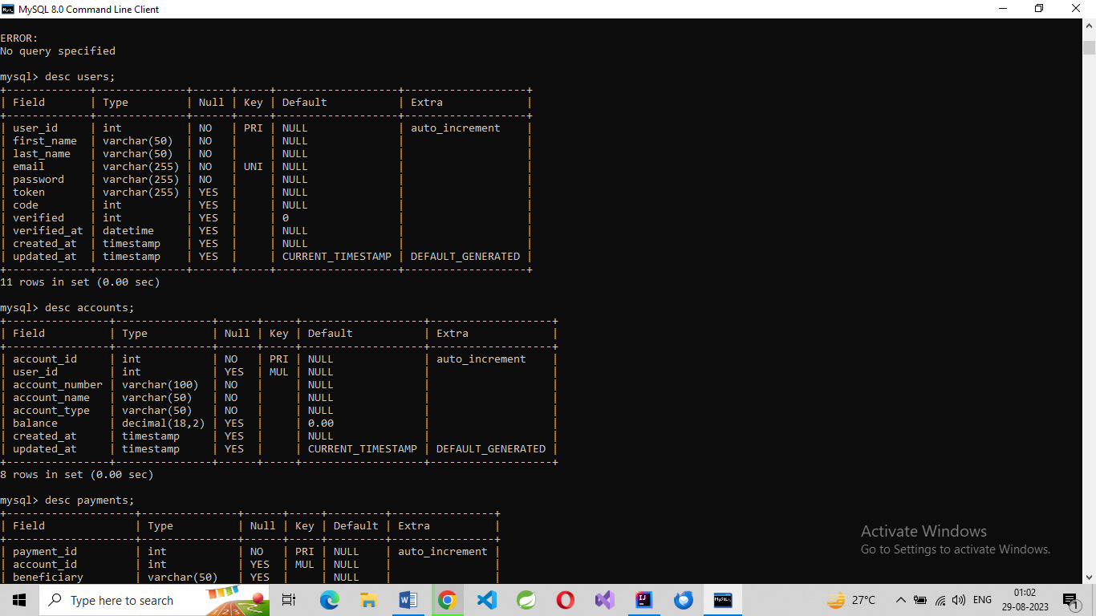
Description of users
and accounts
Choosing Database

Slide 37
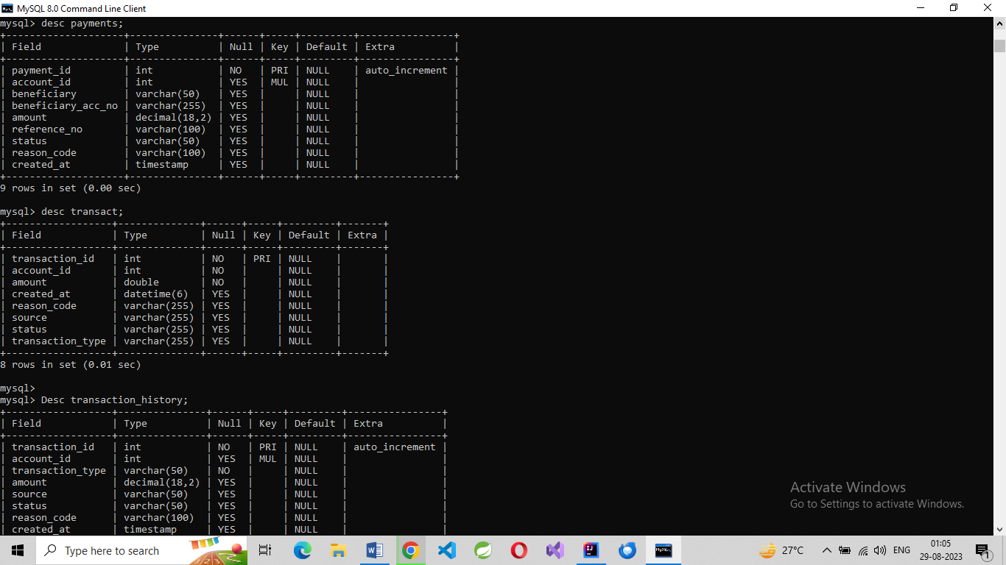
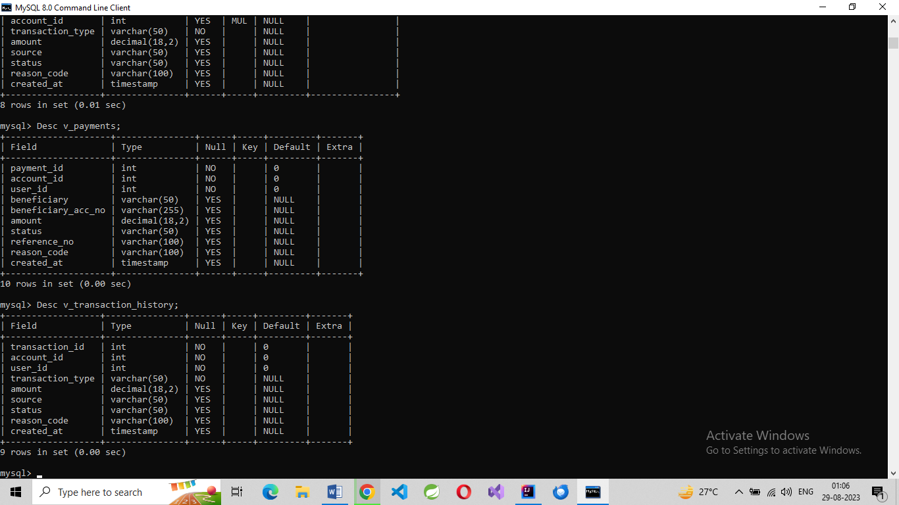
Description of payments, transact
and transaction_history
Description of v_payments
and v_ transaction_history

Slide 38
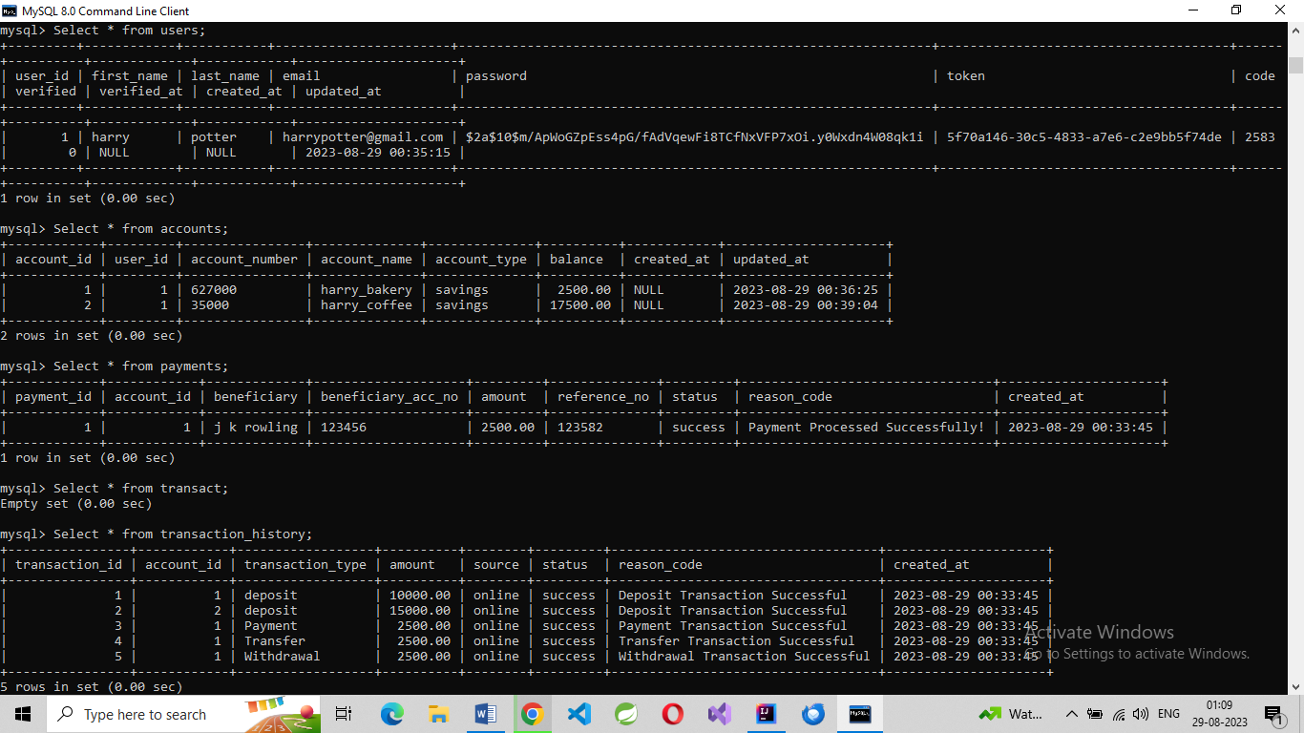
Select * from users; Select * from accounts;
Select * from payments; Select * from transact;
Select * from transaction_history;

Slide 39
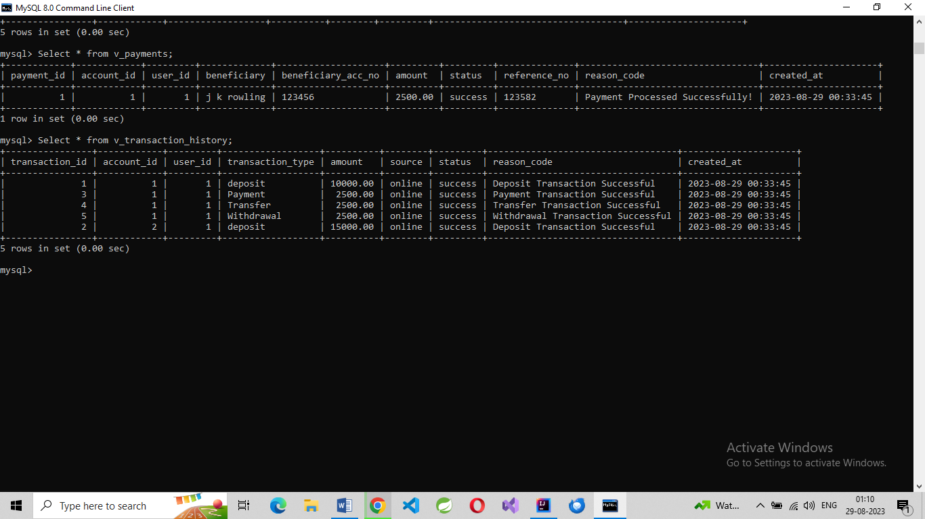
Select * from v_payments;
Select * from v_transaction_history;

Slide 40
Thank You
GitHub link to access bakezy:
https://github.com
/ARPITJAINECE/Bankezy/tree
/f2bf7b2796997008f78693e6895a89f714a227b0
/final_bankezy

